Slide 1
THE PREMIER’S
READING CHALLENGE
2025 @ RHS

Slide 2
WHAT IS IT?
AND WHO CAN DO IT?

Slide 3
The Premier’s Reading Challenge (PRC) is a state-wide reading challenge open to all K-10 students.
Students are challenged to read at least 20 books - 10 of these must be from a set list which has been read and reviewed by teachers and librarians for their quality. These include fiction, non-fiction, graphic novels, and picture books.
Students can also read up to 10 personal choice books as part of the challenge - these are ones that are not on the set booklist, but are selected by the student themselves.
There are some further PRC specific rules (coming up next!).
As they read each book, students must complete a book review and update their online reading record (more on these in a moment!)
Every student who completes their online reading record and has their account validated will receive a certificate signed by the NSW Premier. There are also prize levels for participation (keep reading!)
The challenge finishes on Friday 22nd August at 11:59pm.

Slide 4
PRC RULES
The booklist, personal choice, and series

Slide 5
NO. 1
NO. 3
At least 10 of your 20 books must be from the PRC booklists (there is one for grades 7-9 and one for 9+). You can then choose up to 10 Personal Choice books not on the list. An infographic explaining this can be found on the next slide.
A copy of the booklists can be found in the provided folder. The ‘PRC Booklist @ RHS Library’ document lists the specific texts we have available at RHS library - but you can always borrow from local libraries or a friend!
NO. 2
Up to 5 books from a PRC series (on the booklist) can count towards your total 10. You can read up to 10 more as Personal Choice books. Series that are five books or less do not trigger this rule. Check the explanation two slides on!

Slide 6
THE 20 BOOK BREAKDOWN

Slide 8
There are two things you must do to have each book logged and approved:
Write a book review using the provided template either digitally or physically. There is a digital copy that can be found in the folder. Physical copies can be found in the English staffroom and the library. Both digital and physical copies must be given to Miss Erskine either in the English staffroom or sent to michelle.erskine2@det.nsw.edu.au
Log onto the Student Experience site, go to your reading record, and add your book from the ‘search’ menu. This will automatically update your profile and be sent to Miss Erskine for approval. You
will only be approved once she has received
your book review.
How to Log Your Reading

Slide 9
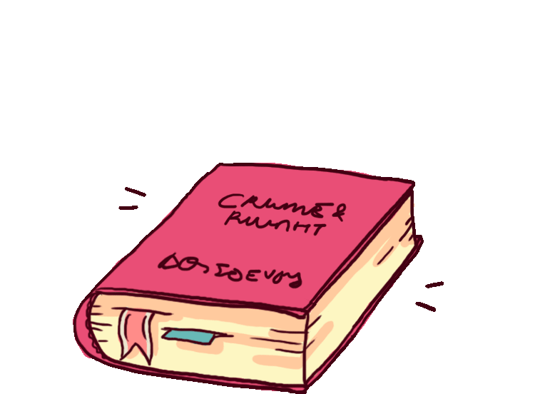
REWARDS
Apart from the PRC-given rewards (to the left), there will also be prizes awarded by the school to those who log the most books, those who create the best book reviews, and those who show the best “spirit of RHS readers”!

Slide 10
Using the Student Experience Site

Slide 20
A FEW LAST THINGS...
You must read all books on your own - no “shared reading” to cut corners!
You must read all PRC books in English. You may read Personal Choice books in your home language.
If you have any specific questions about requirements or help needed, speak to Miss Erskine!

Slide 21
HAPPY READING!
Best of luck, everyone!

